Slide 1
PHP Programming with MySQL
Day 8

Slide 2
Understanding State Information
Information about individual visits to a Web site is called state information
HTTP was originally designed to be stateless – Web browsers store no persistent data about a visit to a Web site
Maintaining state means to store persistent information about Web site visits with hidden form fields, query strings, cookies, and sessions.
State information is used to:
Customize individual Web pages based on user preferences;
Temporarily store information for a user as a browser navigates within a multipart form;
Allow a user to create bookmarks for returning to specific locations within a Web site;
Provide shopping carts that store order information;
Store user IDs and passwords;
Use counters to keep track of how many times a user has visited a site;
The four tools for maintaining state information with PHP are:
Hidden form fields
Query strings
Cookies
Sessions

Slide 3
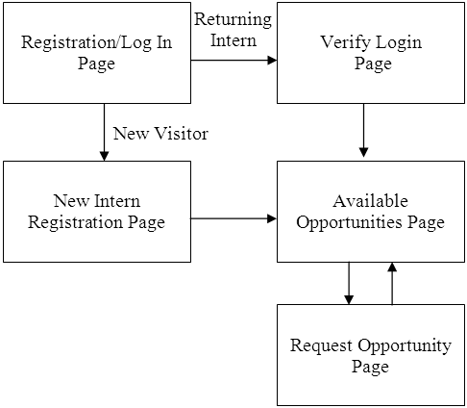
Understanding State Information
Figure 9-1 College Internship Available Opportunities
Web site page flow

Slide 4
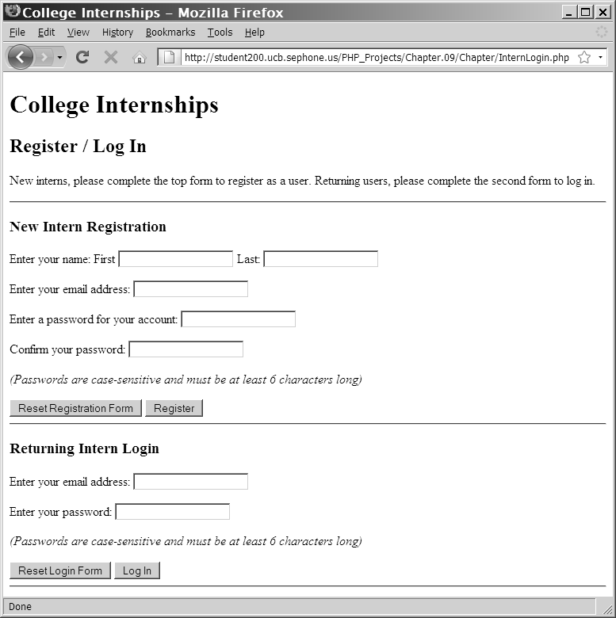
Understanding State Information
Figure 9-2 Registration/Log In Web page

Slide 5
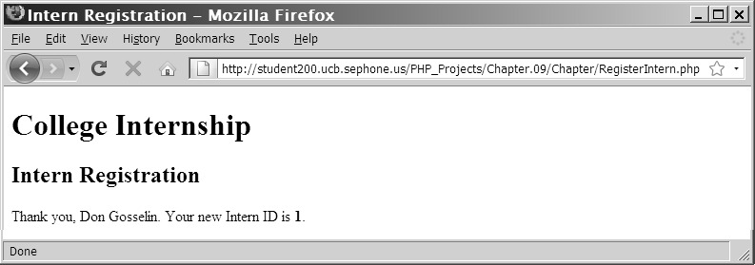
Understanding State Information
Figure 9-3 New Intern Registration Web page
after successful registration

Slide 6
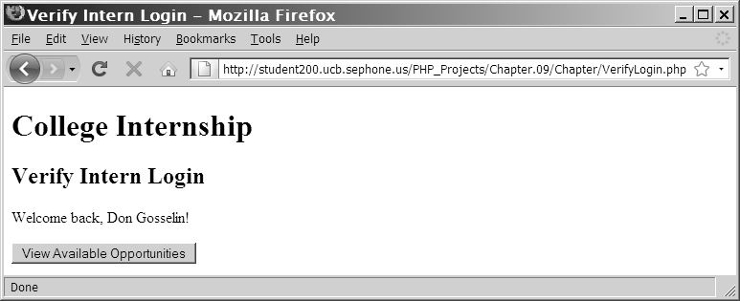
Understanding State Information
Figure 9-4 Verify Login Web Page for a successful login

Slide 7
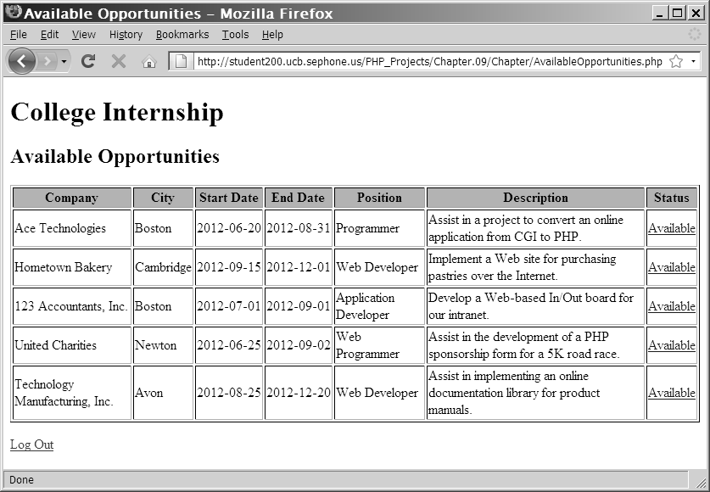
Understanding State Information
Figure 9-5 The Available Opportunities Web page
with the Intern information at top of screen

Slide 8
Using Hidden Form Fields to Save State Information
Create hidden form fields with the <input> element
Hidden form fields temporarily store data that needs to be sent to a server that a user does not need to see
Examples include the result of a calculation
The syntax for creating hidden form fields is:
<input type="hidden">
Hidden form field attributes are name and value
When submitting a form to a PHP script, access the values submitted from the form with the $_GET[] and $_POST[] autoglobals
To pass form values from one PHP script to another PHP script, store the values in hidden form fields

Slide 9
Using Hidden Form Fields to Save State Information
echo "<form method='post' " .
" action='AvailableOpportunities.php'>\n";
echo "<input type='hidden' name='internID' " .
" value='$InternID'>\n";
echo "<input type='submit' name='submit' " .
" value='View Available Opportunities'>\n";
echo "</form>\n";

Slide 10
Using Query Strings to Save State Information
A query string is a set of name=value pairs appended to a target URL
Consists of a single text string containing one or more pieces of information
Add a question mark (?) immediately after the URL followed by the query string that contains the information you want to preserve in name/value pairs
Separate individual name=value pairs within the query string using ampersands (&)
A question mark (?) and a query string are automatically appended to the URL of a server-side script for any forms that are submitted with the GET method
<a href="http://www.example.com/TargetPage .php?firstName=Don&lastName=Gosselin& occupation=writer">Link Text</a>

Slide 11
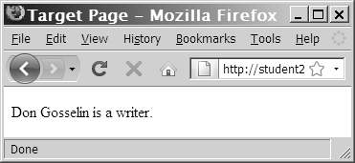
Using Query Strings to Save State Information
echo "{$_GET['firstName']} {$_GET['lastName']}
is a {$_GET['occupation']}. ";
Figure 9-6 Output of the contents of a query string

Slide 12
Using Cookies to Save State Information
Query strings do not permanently maintain state information
After a Web page that reads a query string closes, the query string is lost
To store state information beyond the current Web page session, Netscape created cookies
Cookies are small pieces of information about a user that are stored by a Web server in text files on the user’s computer

Slide 13
Using Cookies to Save State Information
Temporary cookies remain available only for the current browser session
Persistent cookies remain available beyond the current browser session and are stored in a text file on a client computer
Each individual server or domain can store between 20 and 70 cookies on a user’s computer
Total cookies per browser cannot exceed 300
The largest cookie size is 4 kilobytes

Slide 14
Creating Cookies
The syntax for the setcookie() function is:
setcookie(name [,value ,expires, path, domain, secure])
You must pass each of the arguments in the order specified in the syntax
To skip the value, path, and domain arguments, specify an empty string as the argument value
To skip the expires and secure arguments, specify 0 as the argument value

Slide 15
Creating Cookies
Call the setcookie() function before sending the Web browser any output, including white space, HTML elements, or output from the echo() or print() statements
Users can choose whether to accept cookies that a script attempts to write to their system
A value of TRUE is returned even if a user rejects the cookie

Slide 16
Creating Cookies
Cookies cannot include semicolons or other special characters, such as commas or spaces, that are transmitted between Web browsers and Web servers using HTTP
Cookies can include special characters when created with PHP since encoding converts special characters in a text string to their corresponding hexadecimal ASCII value

Slide 17
The name and value Arguments
Cookies created with only the name and value arguments of the setcookie() function are temporary cookies because they are available for only the current browser session
<?php
setcookie("firstName", "Don");
?>
<!DOCTYPE html PUBLIC "-//W3C//DTD XHTML 1.0 Strict//EN"
"http://www.w3.org/TR/xhtml1/DTD/xhtml1-strict.dtd">
<html xmlns="http://www.w3.org/1999/xhtml">
<head>
<title>College Internships</title>
...

Slide 18
The name and value Arguments
The setcookie() function can be called multiple times to create additional cookies – as long as the setcookie() statements come before any other output on a Web page.
setcookie("firstName", "Don");
setcookie("lastName", "Gosselin");
setcookie("occupation", "writer");

Slide 19
The name and value Arguments
The following code creates an indexed cookie array named professional[] that contains three cookie values:
setcookie("firstName", "Don");
setcookie("lastName", "Gosselin");
setcookie("occupation", "writer");

Slide 20
The name and value Arguments
The following code creates an associative cookie array named professional[] that contains three cookie values:
setcookie("professional['firstName']", "Don");
setcookie("professional['lastName']", "Gosselin");
setcookie("professional['occupation']", "writer");

Slide 21
The expires Argument
The expires argument determines how long a cookie can remain on a client system before it is deleted
Cookies created without an expires argument are available for only the current browser session
To specify a cookie’s expiration time, use PHP’s time() function
setcookie("firstName", "Don", time()+3600);

Slide 22
The path Argument
The path argument determines the availability of a cookie to other Web pages on a server
Using the path argument allows cookies to be shared across a server
A cookie is available to all Web pages in a specified path as well as all subdirectories in the specified path
setcookie("firstName", "Don", time()+3600, "/marketing/");

Slide 23
The domain Argument
The domain argument is used for sharing cookies across multiple servers in the same domain
Cookies cannot be shared outside of a domain
setcookie("firstName", "Don”, time()+3600, "/", ".gosselin.com");

Slide 24
The secure Argument
The secure argument indicates that a cookie can only be transmitted across a secure Internet connection using HTTPS or another security protocol
To use this argument, assign a value of 1 (for TRUE) or 0 (for FALSE) as the last argument of the setcookie() function
setcookie("firstName”, "Don", time()+3600, "/", ".gosselin.com", 1);

Slide 25
Reading Cookies
Cookies that are available to the current Web page are automatically assigned to the $_COOKIE autoglobal
Access each cookie by using the cookie name as a key in the associative $_COOKIE[] array
echo $_COOKIE['firstName'];
Newly created cookies are not available until after the current Web page is reloaded

Slide 26
Reading Cookies
To ensure that a cookie is set before you attempt to use it, use the isset() function
setcookie("firstName", "Don");
setcookie("lastName", "Gosselin");
setcookie("occupation", "writer");
if (isset($_COOKIE['firstName'])
&& isset($_COOKIE['lastName'])
&& isset($_COOKIE['occupation'])) {
echo "{$_COOKIE['firstName']} {$_COOKIE['lastName']}
is a {$_COOKIE['occupation']}.";
}

Slide 27
Reading Cookies
Use multidimensional array syntax to read each cookie value
setcookie("professional[0]", "Don");
setcookie("professional[1]", "Gosselin");
setcookie("professional[2]", "writer");
if (isset($_COOKIE['professional'])) {
echo "{$_COOKIE['professional'][0]}
{$_COOKIE['professional'][1]} is a
{$_COOKIE['professional'][2]}.";
}

Slide 28
Deleting Cookies
To delete a persistent cookie before the time assigned to the expires argument elapses, assign a new expiration value that is sometime in the past
Do this by subtracting any number of seconds from the time() function
setcookie("firstName", "", time()-3600);
setcookie("lastName", "", time()-3600);
setcookie("occupation", "", time()-3600);

Slide 29
Exercise
Create a page with a “nag” counter that reminds users to register.
Save the counter in a cookie and display a message reminding users to register every fifth time they visit your site.
Create a form in the body of the document that includes text boxes for a user’s name and e-mail address along with a Registration button.
Normally, registration information would be stored in a database. For simplicity, database registration will be omitted from this exercise.
After a user fills in the text boxes and clicks the Registration button, delete the nag counter cookie and replace it with cookies containing user’s name and e-mail address.
After registering, display the name and e-mail address cookies whenever the user revisits the site.

Slide 30
Using Sessions to Save State Information
Spyware gathers user information from a local computer for marketing and advertising purposes without the user’s knowledge
A session refers to a period of activity when a PHP script stores state information on a Web server
Sessions allow you to maintain state information even when clients disable cookies in their Web browsers

Slide 31
Starting a Session
The session_start() function starts a new session or continues an existing one
The session_start() function generates a unique session ID to identify the session
A session ID is a random alphanumeric string that looks something like: 7f39d7dd020773f115d753c71290e11f
The session_start() function creates a text file on the Web server that is the same name as the session ID, preceded by sess_

Slide 32
Starting a Session
Session ID text files are stored in the Web server directory specified by the session.save_path directive in your php.ini configuration file
The session_start() function does not accept any arguments, nor does it return a value that you can use in your script
<?php
session_start();
...

Slide 33
Starting a Session
You must call the session_start() function before you send the Web browser any output
If a client’s Web browser is configured to accept cookies, the session ID is assigned to a temporary cookie named PHPSESSID
If a client’s Web browser is configured not to accept cookies (check using the get_browser() function), Pass the session ID as a query string or hidden form field to any Web pages that are called as part of the current session:
<?php
session_start();
...
?>
<p><a href='<?php echo "Occupation.php?PHPSESSID="
. session_id() ?>'>Occupation</a></p>

Slide 34
Working with Session Variables
Session state information is stored in the $_SESSION autoglobal
When the session_start() function is called, PHP either initializes a new $_SESSION autoglobal or retrieves any variables for the current session (based on the session ID) into the $_SESSION autoglobal

Slide 35
Working with Session Variables
<?php
session_start();
$_SESSION['firstName'] = "Don";
$_SESSION['lastName'] = "Gosselin";
$_SESSION['occupation'] = "writer";
?>
<p><a href='<?php echo "Occupation.php?"
. session_id() ?>'>Occupation</a></p>

Slide 36
Working with Session Variables
Use the isset() function to ensure that a session variable is set before you attempt to use it
<?php
session_start();
if (isset($_SESSION['firstName']) && isset($_SESSION['lastName'])
&& isset($_SESSION['occupation'])){
echo "<p>" . $_SESSION['firstName'] . " "
. $_SESSION['lastName'] . " is a "
. $_SESSION['occupation'] . "</p>";
}
?>

Slide 37
Deleting a Session
To delete a session manually, perform the following steps:
1. Execute the session_start() function
2. Use the array() construct to reinitialize the $_SESSION autoglobal
3. Use the session_destroy() function to delete the session
<?php
session_start();
$_SESSION = array();
session_destroy();
?>

Slide 38
Summary
Information about individual visits to a Web site is called state information. Maintaining state means to store persistent information about Web site visits
To pass form values from one PHP script to another, you can store the values in hidden form fields, which are submitted along with other types of form fields
One way to preserve information following a user’s visit to a Web page is to append a query string to the end of a URL. To pass information from one Web page to another using a query string, add a question mark (?) immediately after a URL, followed by the query string containing the information you want to preserve in name/value pairs.

Slide 39
Summary
Cookies, also called magic cookies, are small pieces of information about a user that are stored by a Web server in text files on the user’s computer. Cookies can be temporary or persistent.
Temporary cookies remain available only for the current browser session
Persistent cookies remain available beyond the current browser session and are stored in a text file on a client computer
You use the setcookie() function to create cookies in PHP. You must call the setcookie() function before you send the Web browser any output, including white space, HTML elements, or output from the echo or print statements.
Cookies created with only the name and value arguments of the setcookie() function are temporary cookies, because they are available for only the current browser session

Slide 40
Summary
For a cookie to persist beyond the current browser session, you must use the expires argument with the setcookie() function
The path argument of the setcookie() function determines the availability of a cookie to other Web pages on a server
The secure argument of the setcookie() function indicates that a cookie can only be transmitted across a secure Internet connection using HTTPS or another security protocol
To delete a persistent cookie before the time elapses in the assigned expires argument, assign a new expiration value to a time in the past and clearing the value. You do this by subtracting any number of seconds from the time() function and setting the value of the cookie to the empty string.

Slide 41
Summary
Sessions refer to periods of activity when a PHP script stores state information on a Web server. When you start a new session, the session_start() function generates a unique session ID to identify the session. If a client’s Web browser is configured to accept cookies, the session ID is assigned to a temporary cookie named PHPSESSID.
You must call the session_start() function before you send the Web browser any output, including white space, HTML elements, or output from the echo or print statements
You store session state information in the $_SESSION[] autoglobal
To delete a session, execute the session_start() function, use the array[] construct to reinitialize the $_SESSION[] autoglobal and call the session_destroy() function.

Slide 42
Exercise
Convert the “nag” counter you created in the previous exercise into a database registration.
Instead of storing the personal information in a cookie, store it in the database upon successful registration.
Create a login form that validates user name and password against the database, retrieves and puts the user information into a session object.
Using browser tools, check what cookies have been placed in a browser when the session is created.
Add a log out function that clears the session object.

